Slide 1

Machine Learning (IMC-4302C)
Lab 1: Linear regression
School Year 2017-2018

Slide 2
About your tutor and labs
Slim BEN AMOR: Slim.ben-amor@inria.fr
Bachelor from Ecole Polytechnique of Tunisia + Master from Paris-Saclay
Phd Student at INRIA
Online courses achievements (Machine Learning from Stanford and AI from Berkley University)
10 Labs:
2 labs per week
1 report per week (your code for 2 labs + 2-3 pages for your comments/observations on each question)
Grade: 5 reports 50% + Final project 50%

Slide 3
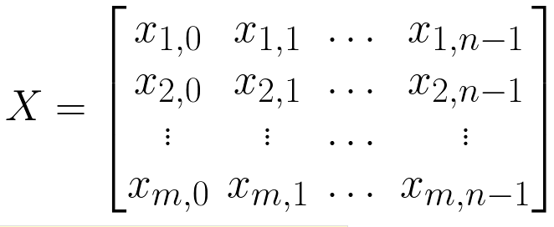

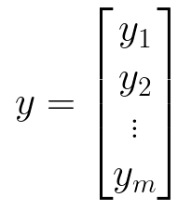
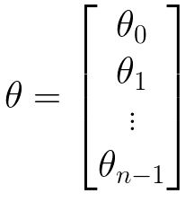

Notation
Where: - m is number of samples - n is number of features including y-intercept (bias)

Slide 4
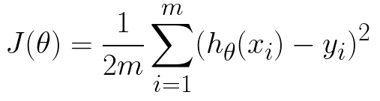
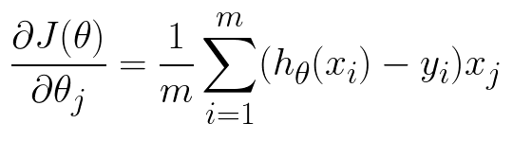

Cost Function: Mean Square Error (MSE)
Cost Function
Partial derivative

Slide 5
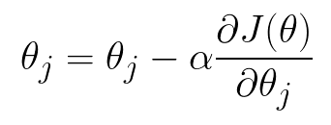
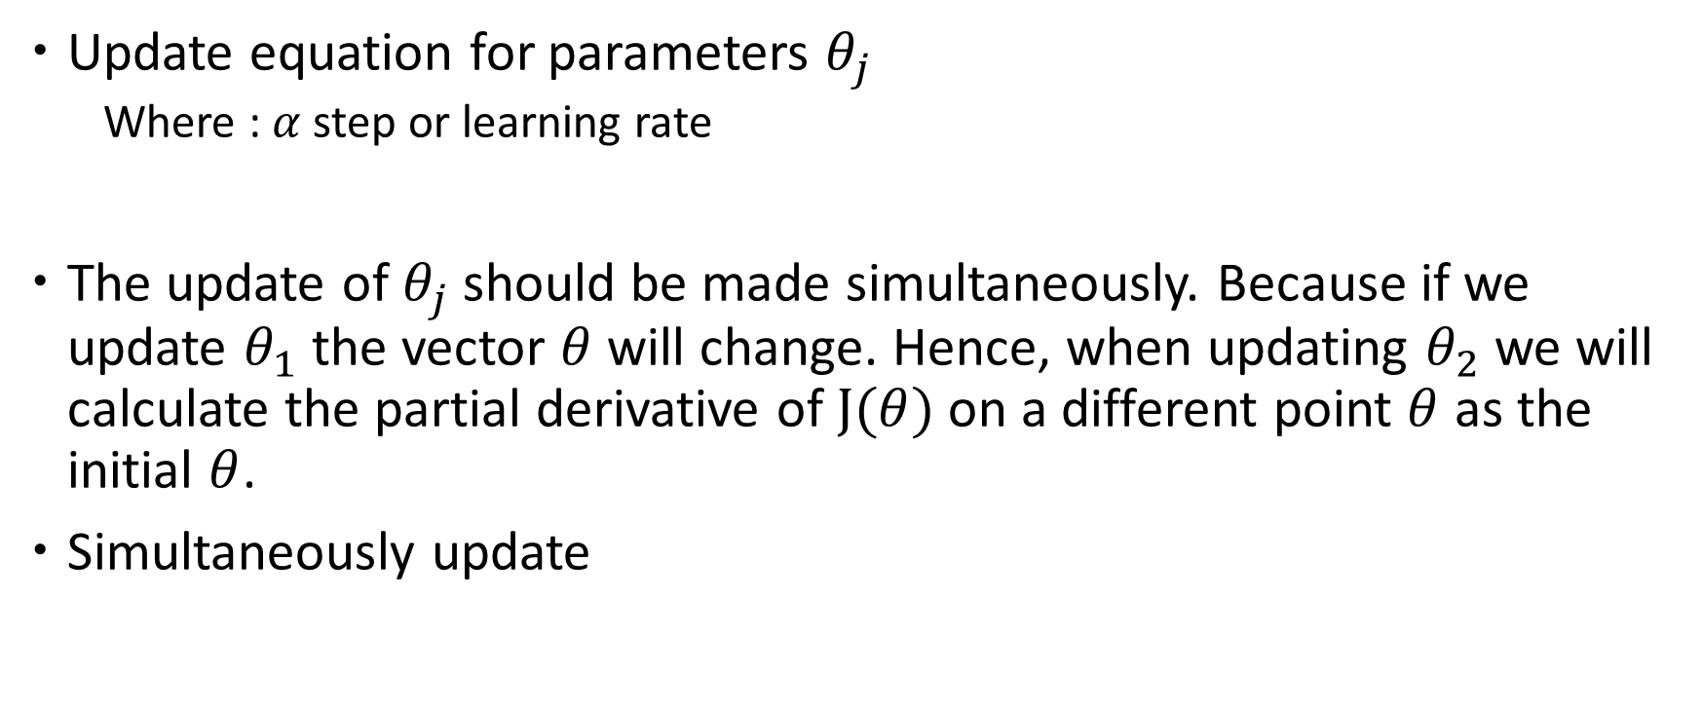
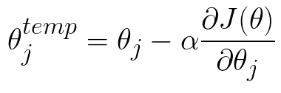

Minimizing Cost Function: Gradient descent Algorithm
Update equation for parameters $θ_{j}$
Where : $α$ step or learning rate
The update of $θ_{j}$ should be made simultaneously. Because if we update $θ_{1}$ the vector $θ$ will change. Hence, when updating $θ_{2}$ we will calculate the partial derivative of $J(θ)$ on a different point $θ$ as the initial $θ$.
Simultaneously update

Slide 6
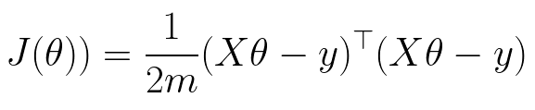
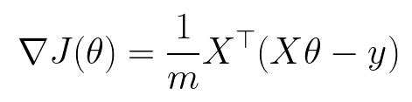

Vectorized Implementation
Cost function
Cost function gradient
Gradient descent update

Slide 7
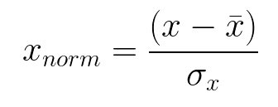

Feature normalization
Cost function
Where : $\overline{x}$ is the mean of $x$
$σ_{x}$ is the standard deviation

